Slide 1
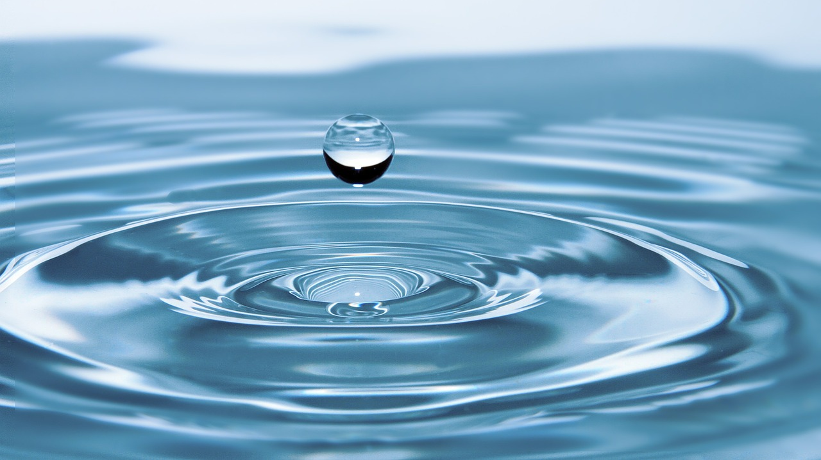
Biomimicry in Art
Wheel Thrown Nesting Bowls

Slide 2
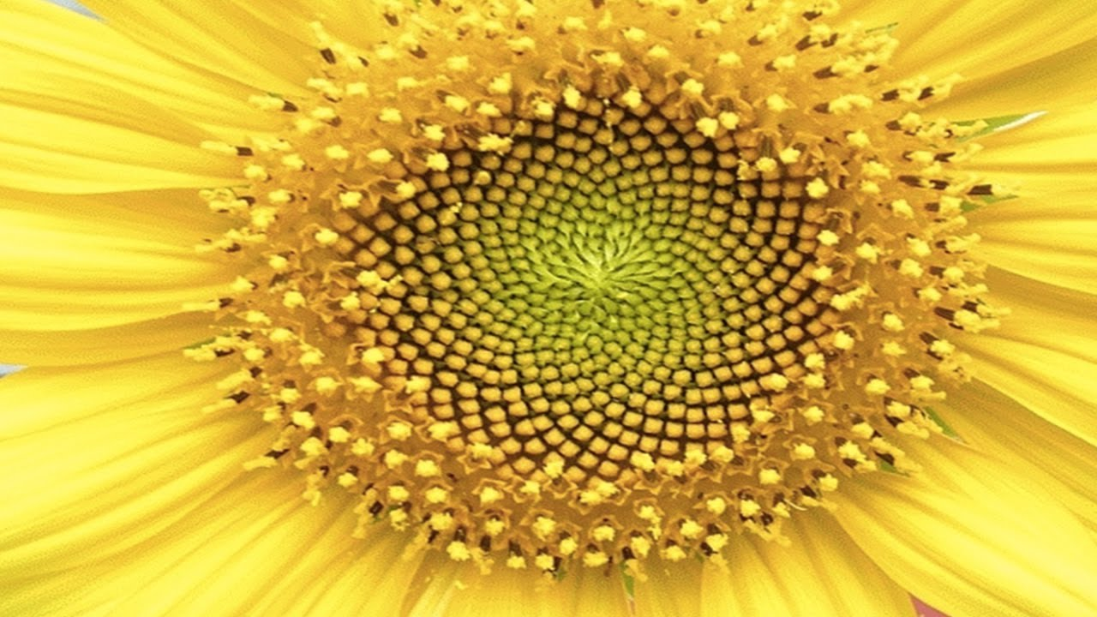
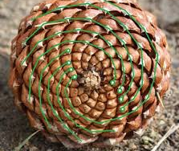
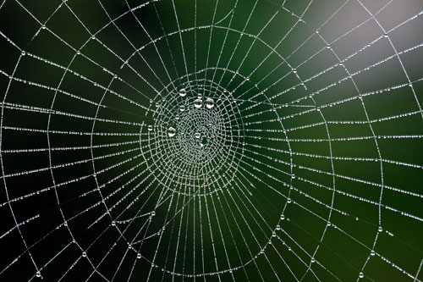
Biomimicry is the design and production of materials, structures, and systems that mimic biological processes.
Many artists use nature as inspiration for their artistic designs. This is a form of biomimicry.

Slide 3
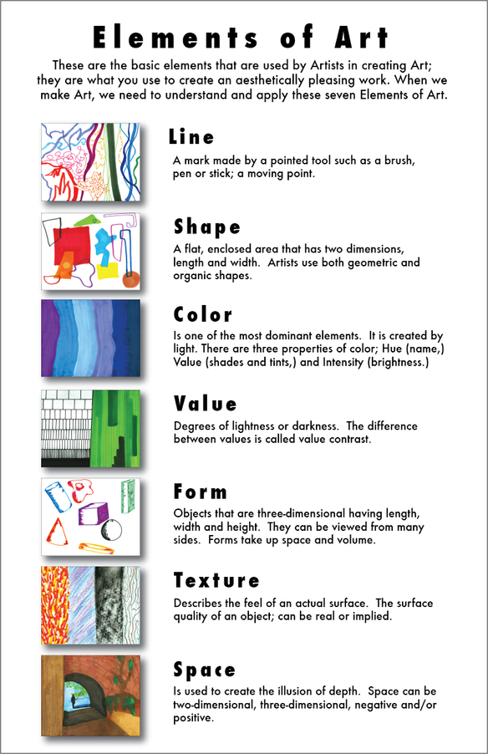
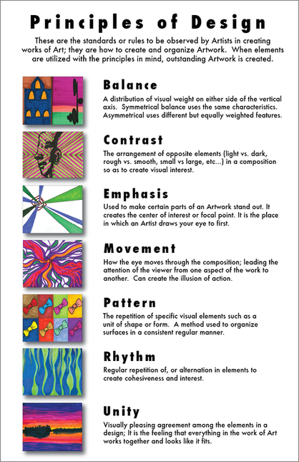
Try to match the images based on the similarities you see in the elements and principles of visual arts you see present.
Once you have them matched based on their similarities, attempt to determine which image is of a natural object or process and which is ceramic vessel

Slide 4
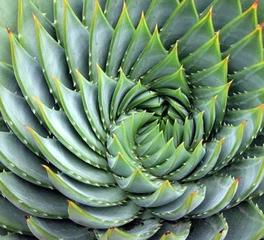
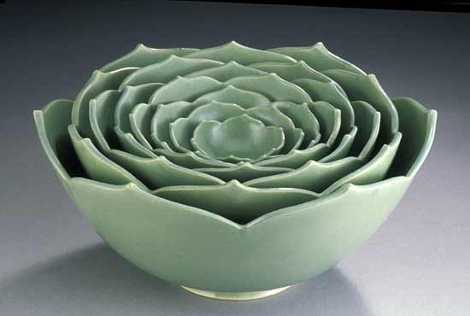

Slide 5
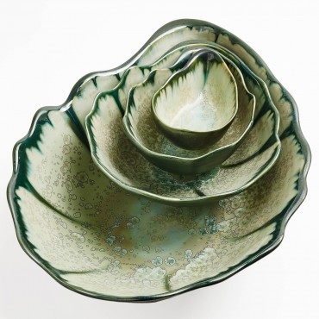
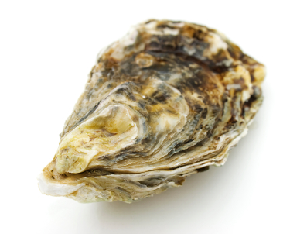

Slide 6
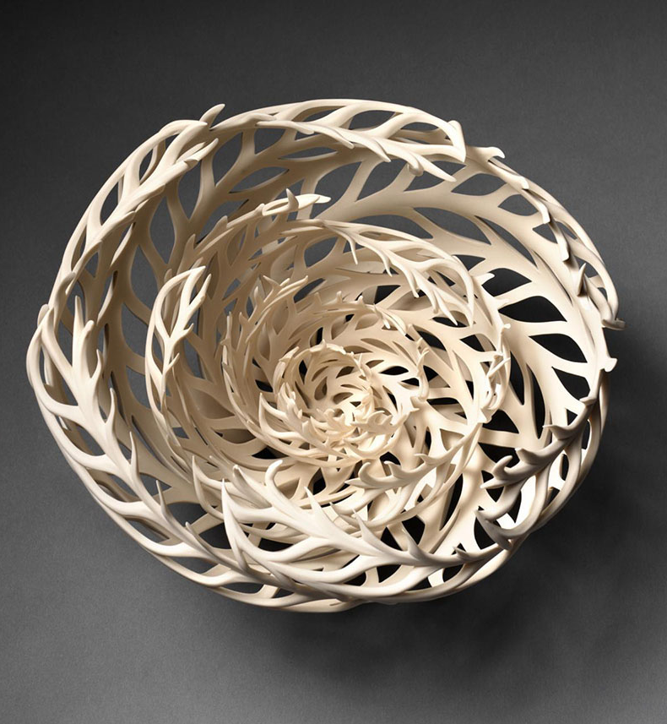
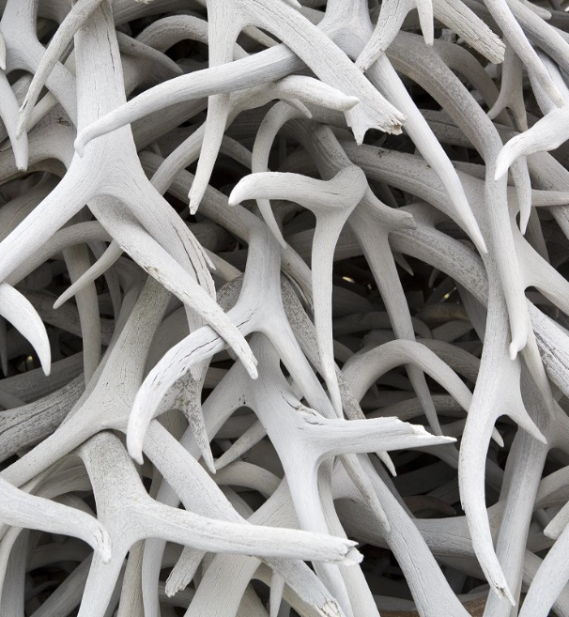

Slide 7
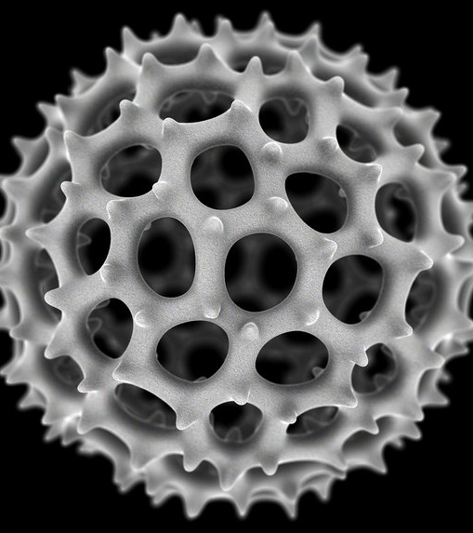
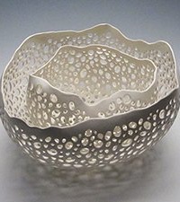

Slide 8
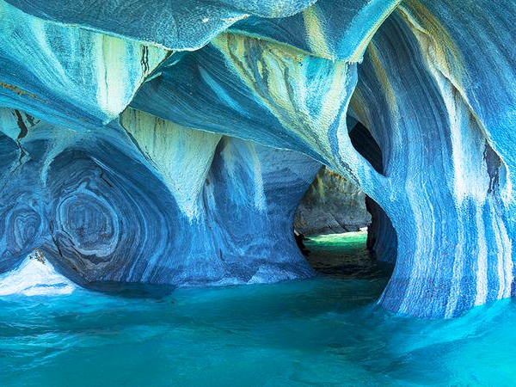
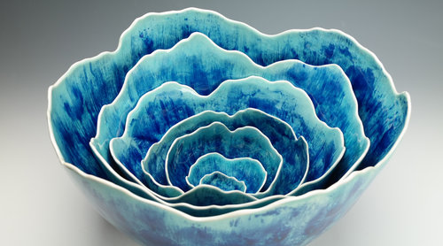
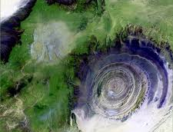

Slide 9
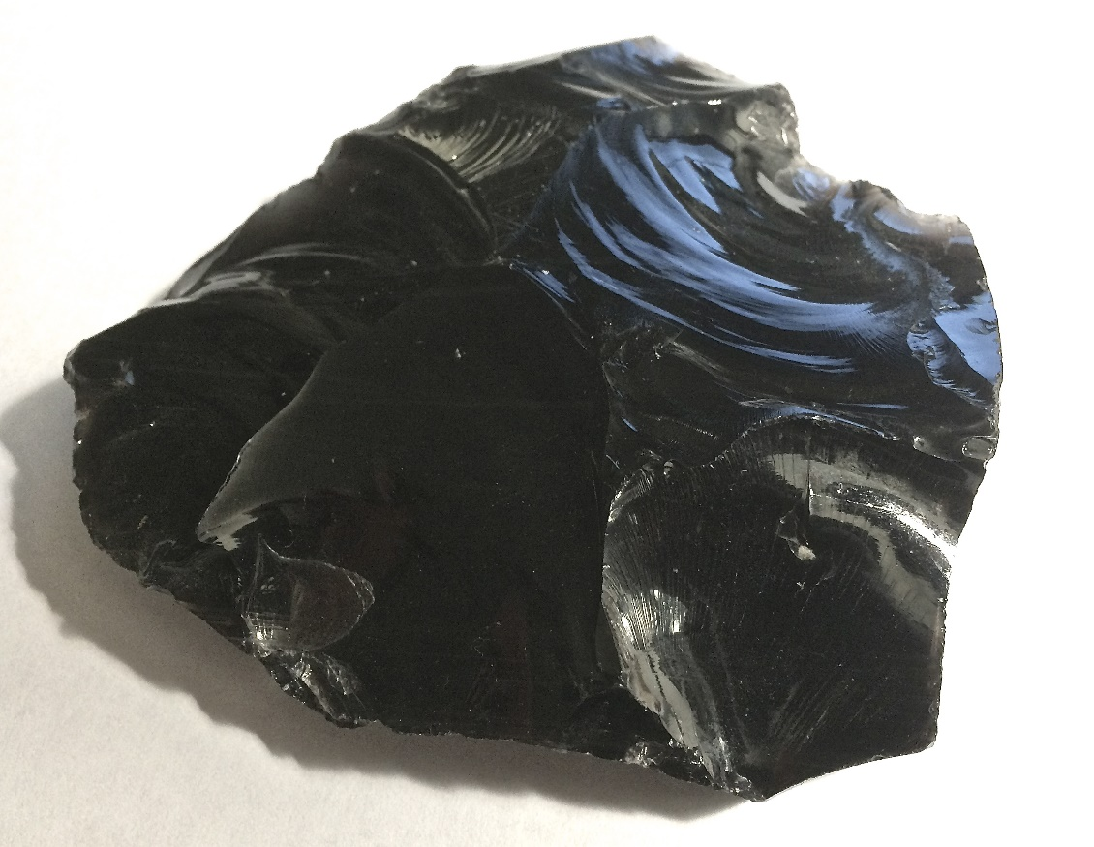
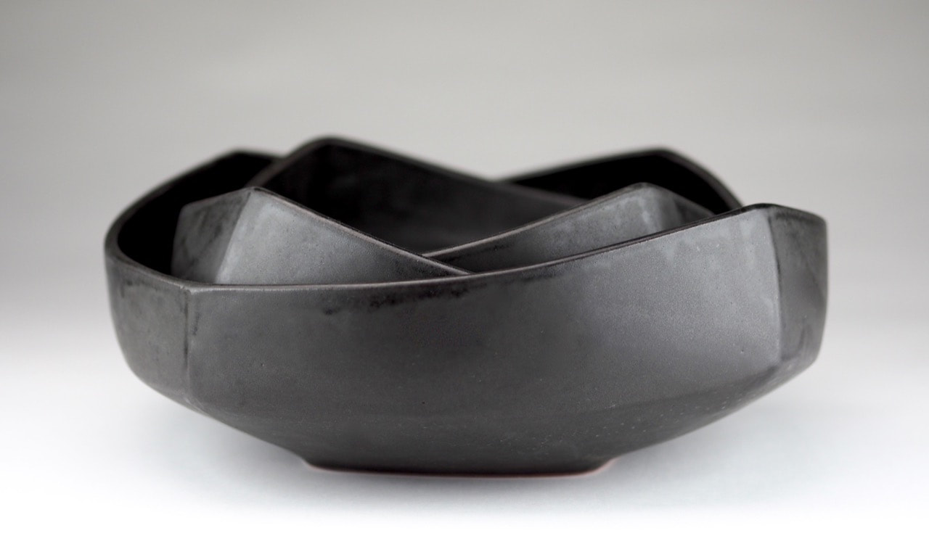

Slide 10
For This Artwork you will:
Add ten images of natural or biological processes or objects that interest you to your project page labeled biomimicry bowls. To help you become familiar with the design of these natural processes, sketch five of them in your sketchbook and upload to your portfolio.
Develop five sketches of nesting bowl designs that incorporate inspiration from a natural process or object. Keep in mind you can communicate your idea through imagery, the form/shape of the vessel, surface design, or even function.
Make a series of 3 wheel-thrown bowls that fit within each other to form a set. Consider surface treatment and form when unifying the bowls. Consider the rim, the inside curve and the foot of each bowl. The bowls can be the same size or be of varying sizes, but must fit within each other.

Slide 11
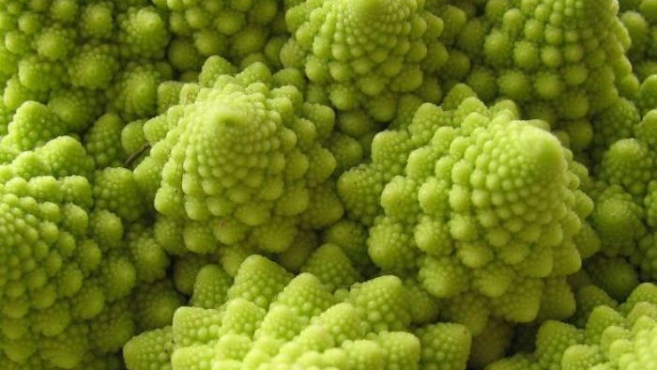

Slide 12
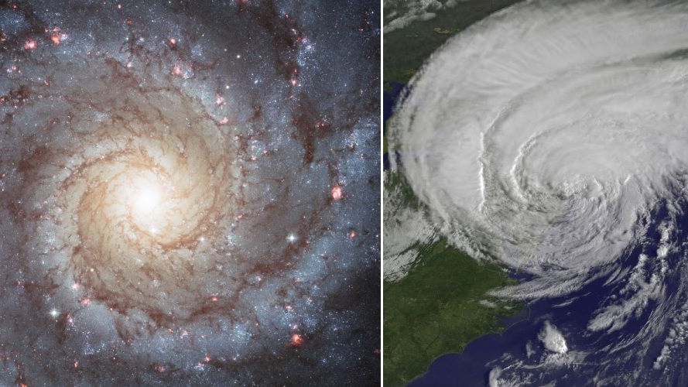

Slide 13
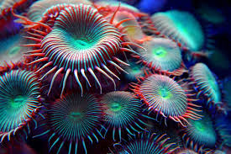

Slide 14
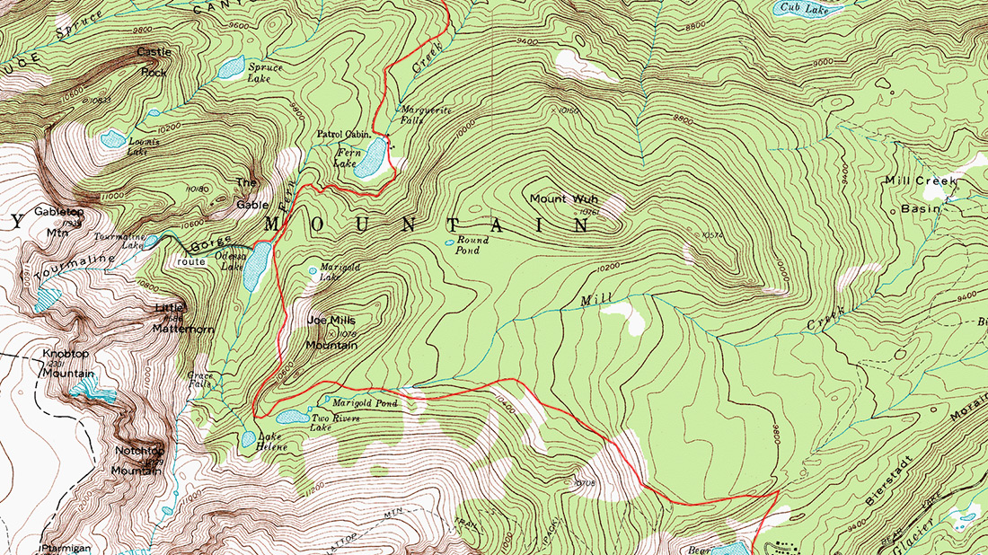

Slide 16
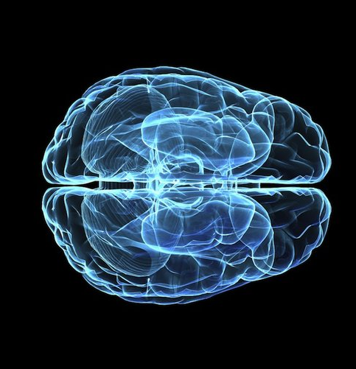
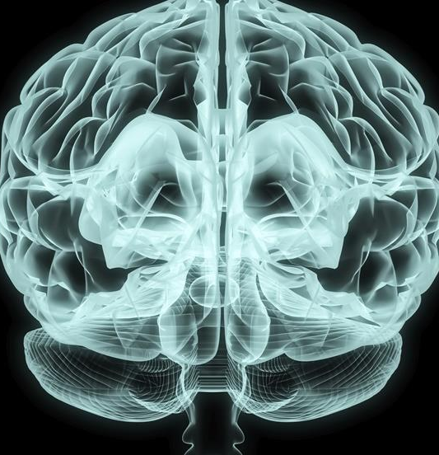

Slide 17
