Slide 1
Claim, Support, Question
Making Thinking Visible Strategy Breakdown

Slide 2
1. Make A Claim about the topic, issue or idea being explored
A claim is an explanation or interpretation of some aspect of what is being examined. A claim can be a conjecture, speculation, generalization, assertion, statement of fact, theory, hypothesis, etc.

Slide 3
2. Identify the Support for your claim
State the things you see, feel or know that lend evidence to your explanation.

Slide 4
3. Present a question that is related to your claim
Do you still have some doubts about your claim? What further issues does your claim unearth? What isn’t fully explained by your claim? This is when you encourage students to think about what evidence could support the opposing side of the claim being made.
This also enables students to think more deeply about the claim and transfer the knowledge they’ve just gained to other topics of inquiry.

Slide 5
WHY?
This strategy can be used to help students evaluate the claims of others, or to develop their own claims about a certain topic.
Having to identify evidence to support ideas or opinions offers opportunities for students to visualize their thinking.
This type of critical thinking about claims of fact or opinion can be a valuable skill in any content area as well as in the real world.
This strategy discourages blindly accepting information, and encourages students to think and make assumptions based on authentic investigation.

Slide 6
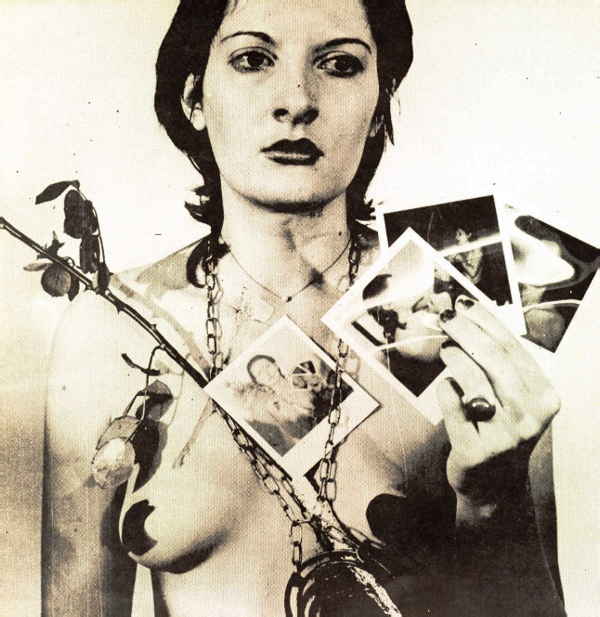
Now Lets see it in action
"Once, Picasso was asked what his paintings meant. He said, 'Do you ever know what the birds are singing? You don’t. But you listen to them anyway.' So, sometimes with art, it is important just to look.“
–Marina Abramovic
"To me the pain and the blood are merely means of artistic expression.“
– Also Marina Abramovic

Slide 7
What is art?
Keep this question in mind as you listen to Marina Abramovic’s commentary on her 1974 performance piece, Rhythm 0.
https://www.youtube.com/watch?v=kijKz3JzoD4

Slide 8
Consider these questions about what you just experienced
Can Abramovic’s performances be considered works of art?
What makes something a work of art?
What message is Abramovic attempting to communicate through her performances?

Slide 9
1. Make A Claim about the topic, issue or idea being explored:
State a conjecture, speculation, generalization, assertion, statement of fact, theory, hypothesis, etc.
2. Identify the Support for your claim:
State the things you see, feel or know that lend evidence to your explanation.
3. Present a question that is related to your claim:
Do you still have some doubts about your claim? What further issues does your claim unearth? What isn’t fully explained by your claim?

