Slide 1
Reliquaries in Clay

Slide 2
Objects hold meaning
I want you to think of an object that holds significance or meaning to you.
It could be a piece of jewelry, a special rock, gem or shell, a photograph or note, a figurine, a fishing lure, a trinket, or even an everyday object like a key or a watch.
It must be something that could fit in a shoe box, but that has a special meaning to you because it reminds of a memory, an emotion, a person, pet or place.
Create a project page in your digital portfolio and name it “Reliquaries in Clay”
Create a list of 4-5 objects that hold personal meaning and explain why they are important to you.

Slide 3
Inquiry Questions- keep these in mind as we look through the following slides.
What gives an object personal significance? How do the memories and emotions we attach to an object transform it into something more special or important?
How can we create a vessel suitable to hold an object so special?
How does the form of a vessel affect the function of that vessel? How can the appearance and structure of a vessel communicate information about what it holds?

Slide 4
What is a reliquary?

Slide 5
A reliquary is very simply a vessel that holds a relic.
But What is a relic?

Slide 6
A Relic IS:
An object surviving from an earlier time, especially one of historical or sentimental interest.
A surviving memorial of something past
All that is left of something.
In simpler language, it is an object that holds significance or meaning.

Slide 7
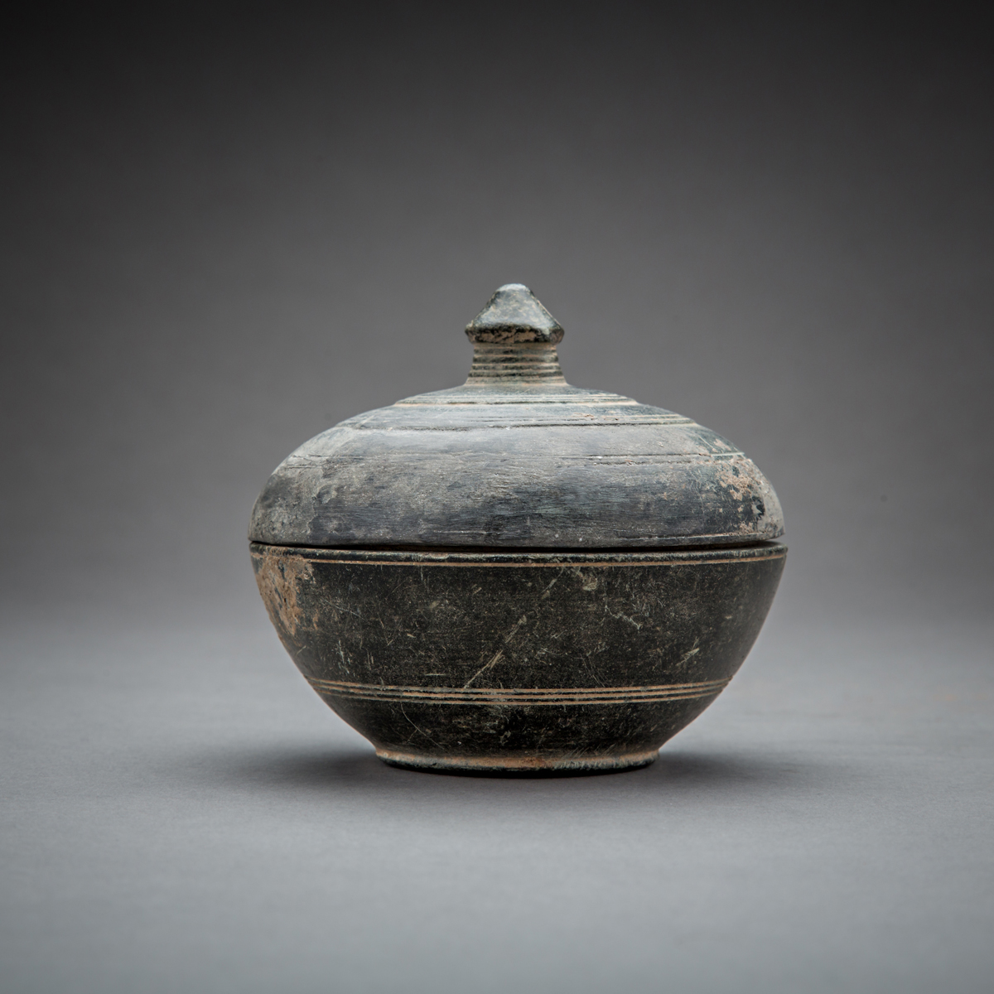
Historic reliquaries
Notes:
This is a Buddhist reliquary. The ashes of the original Buddha (the first Buddhist priest to reach enlightenment) were said to have been split up into nine groups and later, 84,000 different portions that were housed in Stupas used for worship. As Buddhism spread, the ashes became less available so polished sacred stones and bone fragments of highly esteemed Buddhist priests were used as stand-ins for the original relics. The shape of this reliquary is meant to resemble a wish-granting jewel which signifies specific Buddhist deities and their ability to answer prayers.
https://collections.artsmia.org/art/99722/buddhist-reliquary-in-the-shape-of-a-wish-granting-jewel-unknown-japanese

Slide 8
Head of Mary Magdalene in Saint Maria Maddalena
Notes:
http://factsanddetails.com/world/cat55/sub391/entry-5789.html
Design choices reflect significance of object: Material chosen is gold and the container is shaped like the head of a woman.

Slide 9
Notes:
This is a Christian Reliquary said to house a portion of Jesus Christ’s clothing. Notice the crown motifs at either end of the vial signifying “The King of Kings”
https://sites.tufts.edu/textilerelics/

Slide 10
The Polynesian diety A’a
Notes:
This is a figural sculpture of the Polynesian God of fertility A’a . On the back side of his body there is a small cavity that holds the skull and bones of an important ancestor. In this case, the actual shape of the figure reflects the “figure” that it holds.

Slide 11
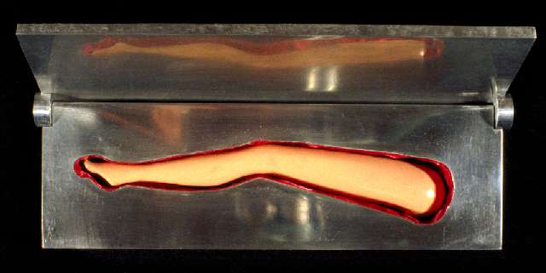
Schip’s Modern Reliquaries
Notes:
This artist creates reliquaries that elevate everyday objects to the height of sacred. How are the vessels fitting to the object they hold?

Slide 12
Becky McDonah’s Lake Defense: Reliquary for Mosquito Repellent.

Slide 13
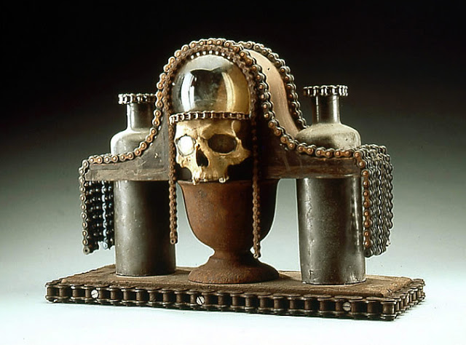
Gothic Reliquaries of Al Farrow

Slide 14
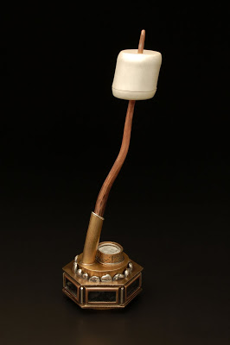
Becky Chader: Inspriational Ashes

Slide 15
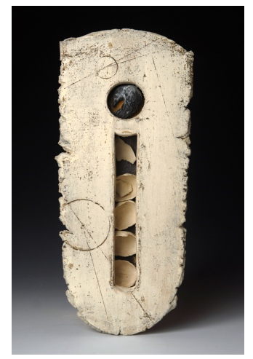
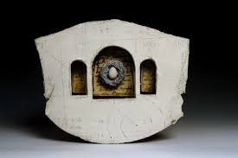
Novie Trump Ceramic Reliquaries
Notes:
Her reliquaries comment on the idea of home/shelter. Her relics are fragile but contained in stronger ceramic vessels. How are the vessels related to what they are holding? https://www.novietrump.com/reliquaries

Slide 16
Reliquaries in clay
You will be creating a vessel to hold one of the significant objects you listed earlier.
When designing your vessel, keep in mind that the shape, texture, color, and imagery you use must be related to the object the vessel holds.
Choose three objects from your earlier list. In your sketchbooks, create a concept map to begin brainstorming about ideas associated with each of your three objects. Photograph this map and add it to your digital portfolio.
Notes:
Bring back my object examples – show example of concept map

Slide 17
Once you have decided on an object to hold in your reliquary, develop three sketches of a vessel that could hold this significant item. Keep in mind that your choices about shape, color, imagery, and texture of your vessel should be related to the object it holds.
Add these sketches to your digital portfolio and be ready to discuss them Monday

Slide 18
Sketch reflections
What parts of your design do you think will be difficult to fabricate? What parts will be easy?
How does your design’s form reflect it’s function? How does its surface design, color, shape, surface texture and other characteristics communicate information about what the vessel holds?
How did your idea for your vessel change as you sketched your ideas?

