Slide 1
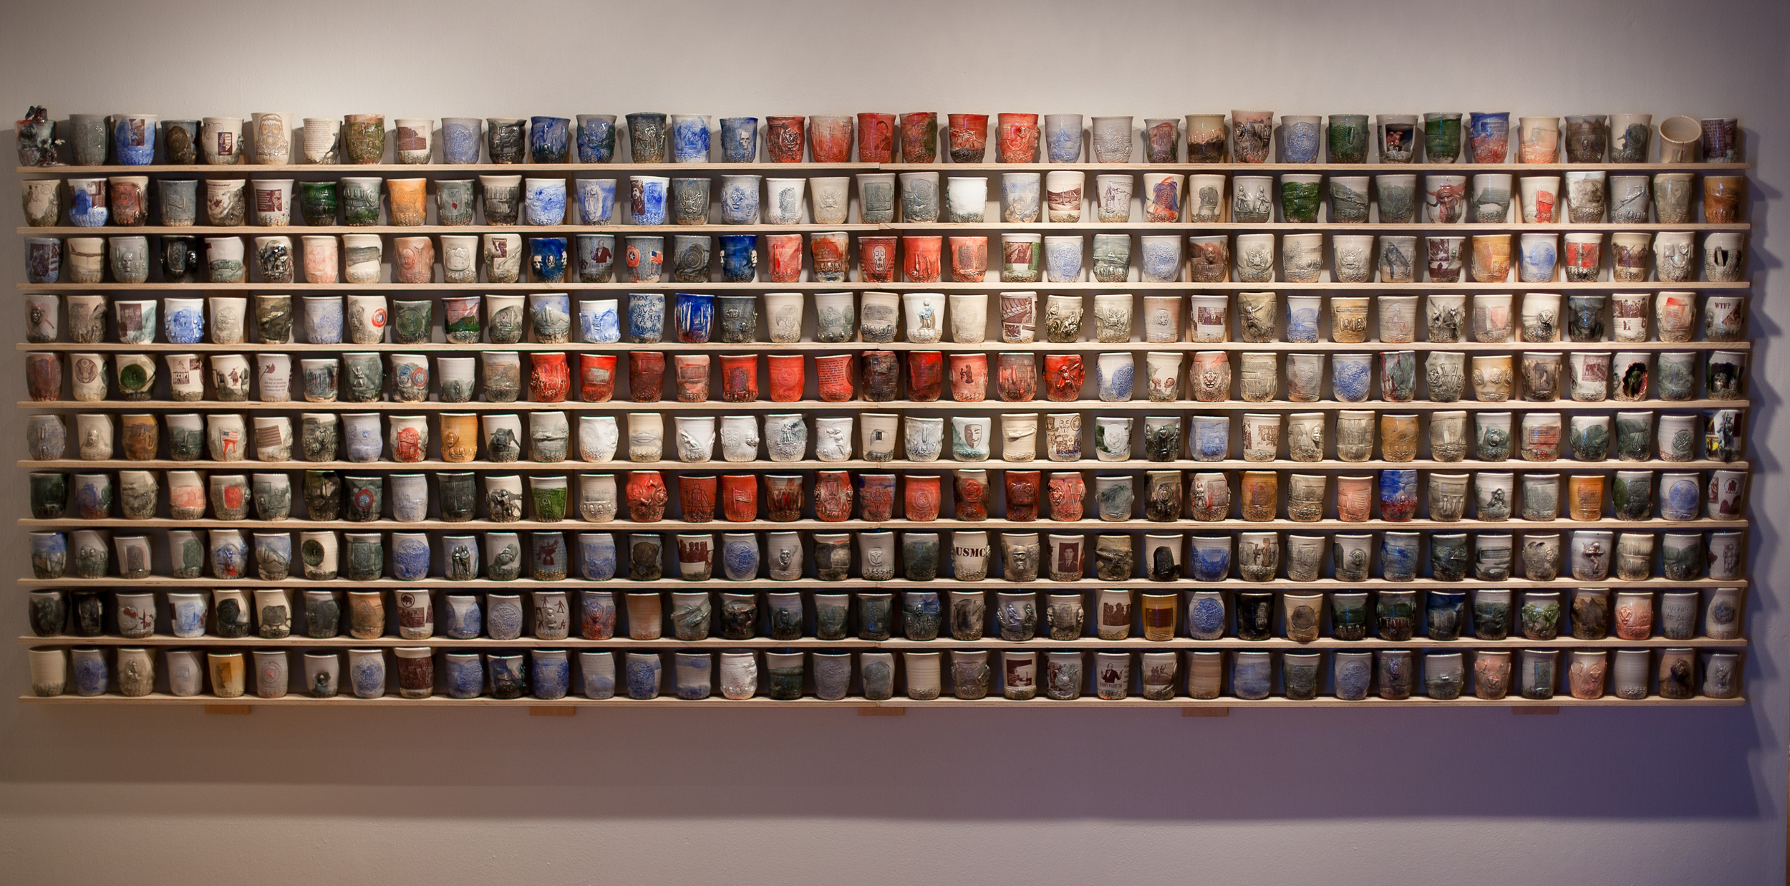
Serving Up Social Justice
"There's nothing I do that I think will change the world, but there's nothing in the world that releases me from my obligation to try."

Slide 2
Think of Your Most Important Core Values
Core values are your fundamental beliefs. These guiding principles dictate your behavior and help you understand the difference between right and wrong.

Slide 3
Core Values
Compassion
Family
Integrity
Empathy
Perseverance
Respect
Equality
Honesty
Authenticity
Balance
Community
Faith
Justice
Love
Openness
Peace

Slide 4
Social Issues:
War
Environmental Sustainability (Global Warming, Pollution)
Civil Rights
Women’s Rights
Gay Rights (LGBTQ)
Animal Rights
Gun Violence and Public Shootings
Mental Health and Suicide
Healthcare
Addiction
Domestic Abuse
Poverty/ Starvation
Bullying
Immigration

Slide 5
Social Justice
Fair and Just relations between the individual and society involving equal access to opportunities and privileges.
Does your society uphold or challenge your core values?

Slide 6
Ehren Tool- Artist and Activist
https://www.craftinamerica.org/episode/service
Why did Tool use cups as his vehicle for awareness?
How did the imagery on his cups represent the social issue he addressed?
How did he take his artwork a step further to communicate his message about war?

Slide 7
Servin’ Up Social Justice
The Fort Collins Art Association is holding a community dinner to raise awareness about important social issues. You have been asked to design a platter which will visually represent issues important to you in order to catalyze a conversation about difficult topics. You will use surface design techniques including glazing, texture application, stencils, and stamps to create a story about social justice on your platter.

Slide 8
https://www.novica.com/p/green-stoneware-ceramic-serving-platter/64650/

Slide 9
Platter Designs and Surface Design Ideas
Clay Coyote Pottery
Notes:
Clay Coyote Pottery

Slide 10
Sue Tirrel
Notes:
N3 Pottery

Slide 11
N3 Pottery
Notes:
N3 Pottery

Slide 12
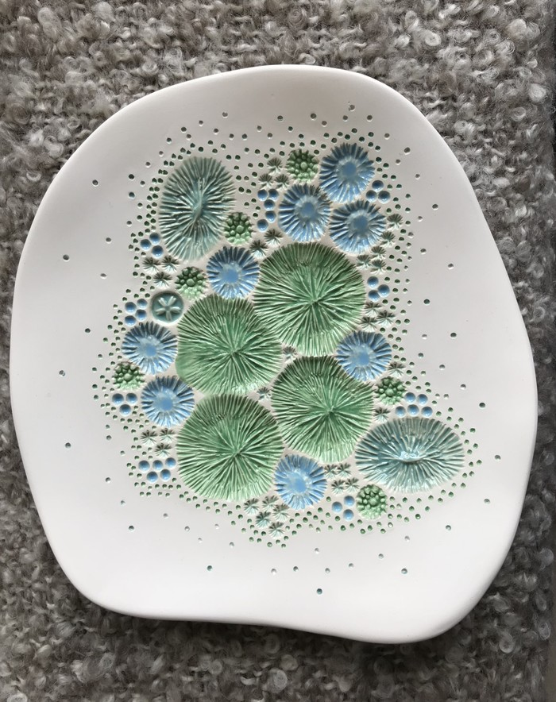
https://madeit.com.au/Main/Item?itemId=1230834&tellafriend=true

Slide 13
https://www.thedemocraticcup.com/collections/all

