Slide 1
Shared Experience Rings

Slide 2
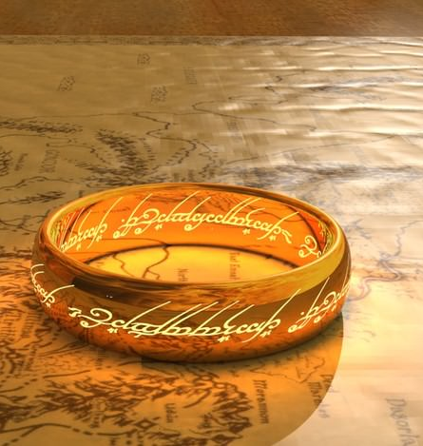
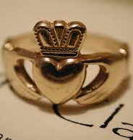
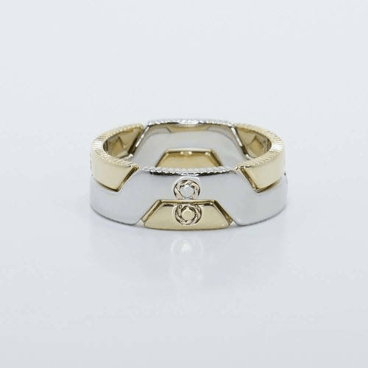
Art of adornment, specifically rings, have been used historically and across cultures to symbolize meaningful relationships.
Notes:
Byzantium Wedding Ring, 7th century A.D. Photo courtesy of Wikimedia. © Jastrow (2005).
Custom Interlocking Puzzle Men’s Band

Slide 3
What person in this world do you share an unbreakable bond or connection with?
Create a list of three people who you share an unbreakable connection with on your project page labeled “Shared Experience Rings”
Think about the person who’s life is the hardest to separate from your own. The people you’ve shared the most memories with and with whom you want to continue to create memories with.

Slide 4
Choose One of those People and Brainstorm Three Experiences you shared with them:
Create a list in your digital sketchbook of the meaningful experiences you shared with this person. They can be happy or sad, life changing or everyday events you value.

Slide 5
Choose one of those shared experiences and write the story of that experience from your perspective
Include the beginning, middle, and end of this story and why this experience was meaningful to you.

Slide 6
Create a List of Ten Important elements of your story:
Think about the emotions you felt, the things you saw, the concepts you associate with the experience.

Slide 7
Develop Four Sketches of Symbols that could represent these emotions, concepts, and elements
Think about how you could use specific imagery, form, shape, symmetry, line, etc to represent your elements or concepts

Slide 8
Combine two or more of these symbols into three final sketches for your ring design:
Keep in mind how these symbols will transfer to metal. Will they be elements of positive and negative space in the band, will they be elements soldered onto the ring, will they be represented through patina?
Document your planning through photos of your sketches on your digital portfolio.

Slide 9
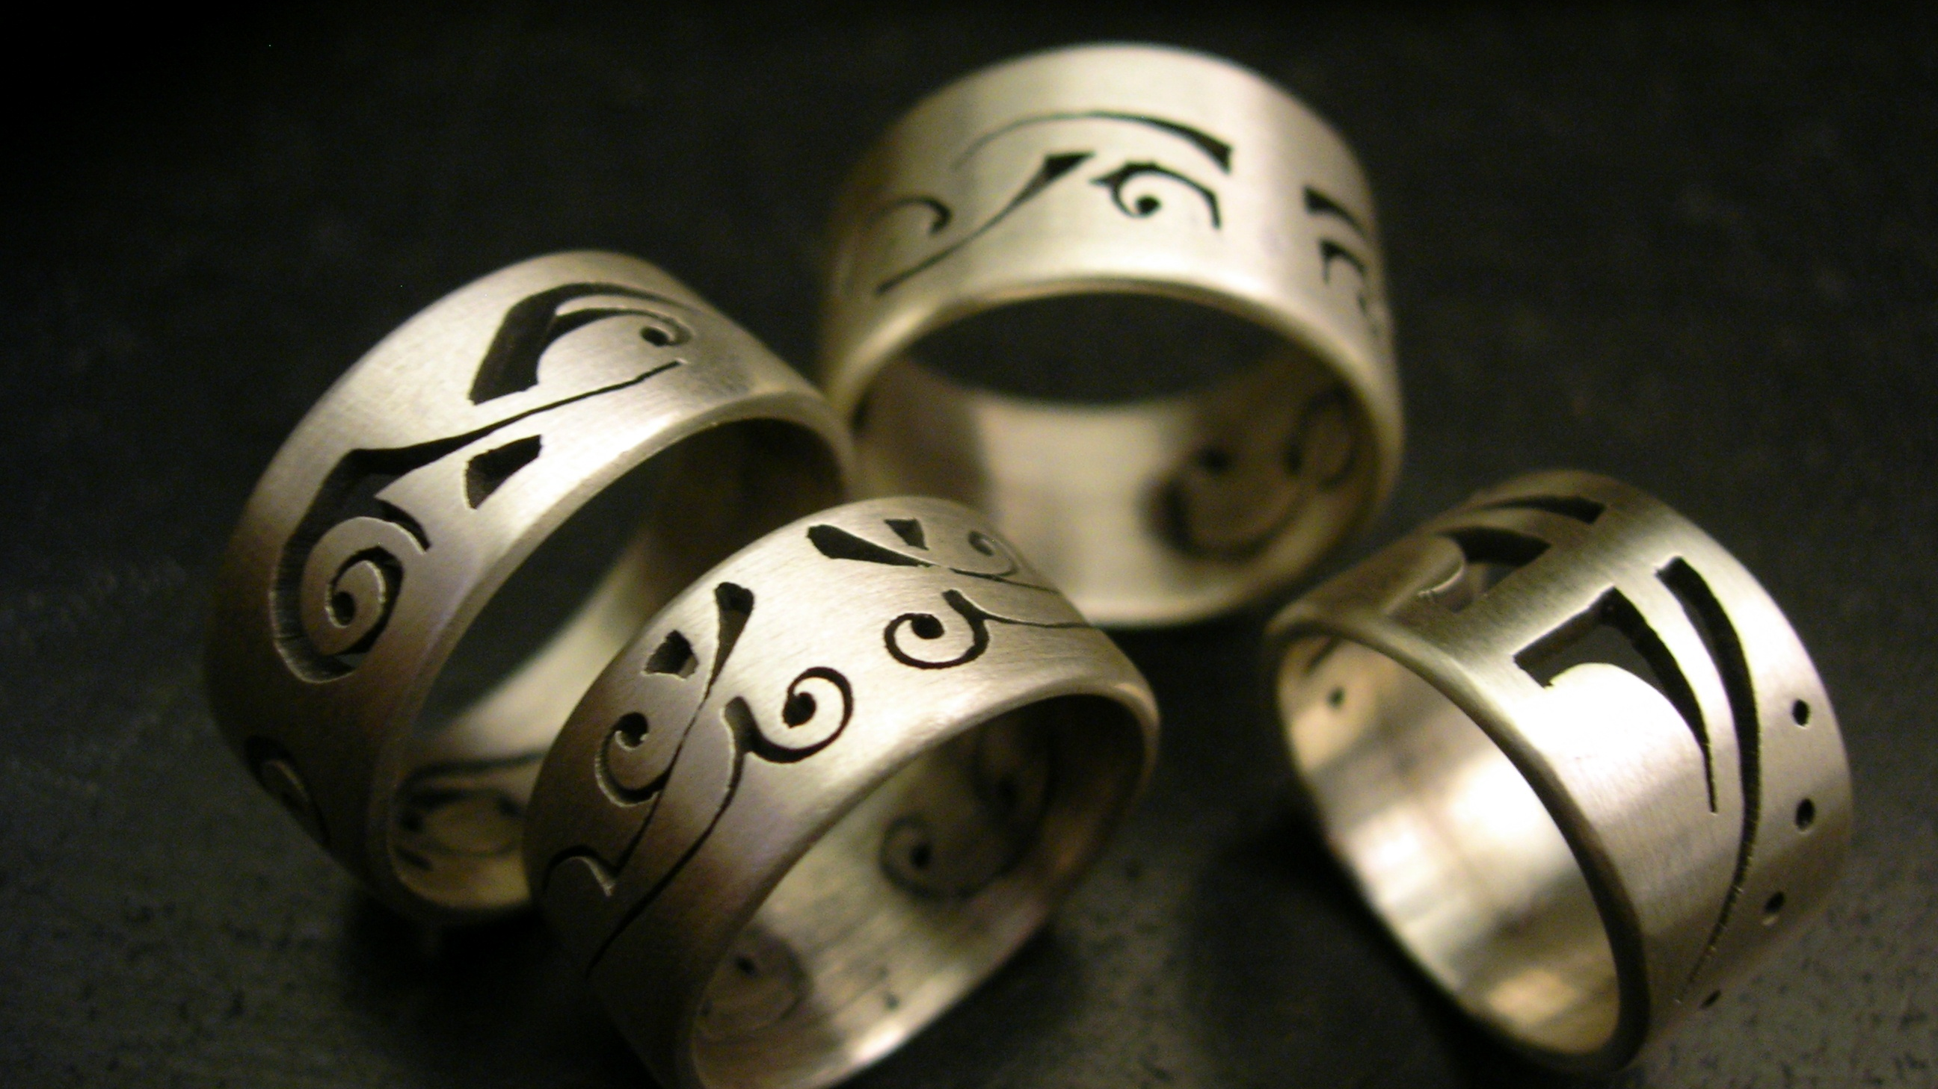

Slide 10
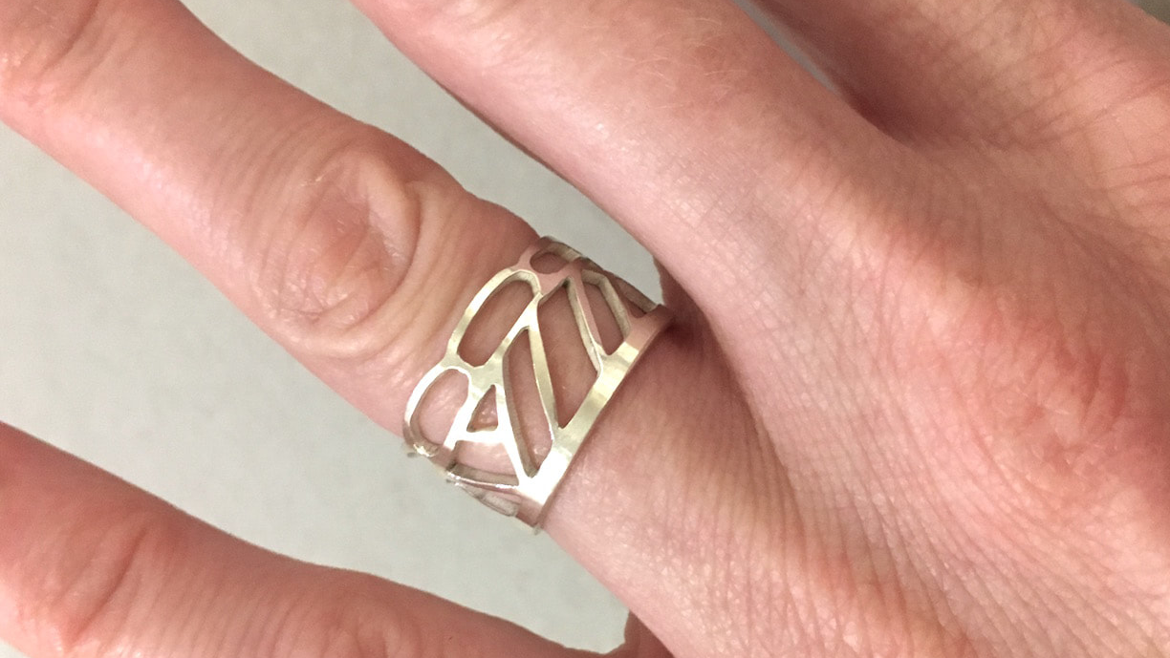

Slide 12
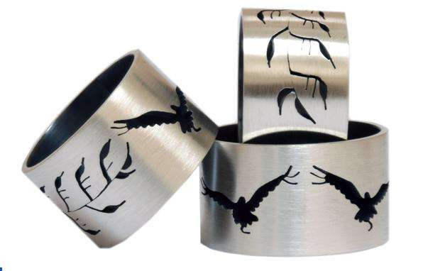

Slide 13
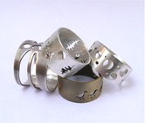

Slide 14
